Slide 1
Construction Clients’ Group Safety in Design
Watercare
February 2019

Slide 2
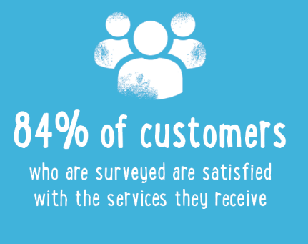
Watercare Fast Facts
1

Slide 3
